Slide 1


BUA 751: Machine learning for business Homework 2: Indian liver patient
Group – 6:
Shiva Dhanush Mallela
Sravan Kumar Mandhadapu
Rishi Siddanth Yaga
Harshitha Reddy Yerramorrusu

Slide 2

Dataset – Indian liver patient
This information came from the repository of machine learning datasets at the University of California, Irvine. This dataset includes the following data fields:
Data Fields:
Patient age – age of the patient in years (Integer).
Gender – Gender of the patient(Binary – male=1 or female=0).
Total Bilirubin– continuous variable.
Direct Bilirubin– continuous variable.
Alkaline Phosphatase – Integer.
Alamine Aminotransferase – Integer.
Aspartate Aminotransferase – Integer.
Total Proteins – continuous variable.
Albumin – continuous variable.
Albumin and Globulin Ratio – continuous variable.
Disease – (1 = patient with liver disease, 0 = no disease).

Slide 3

visualizations

Slide 4
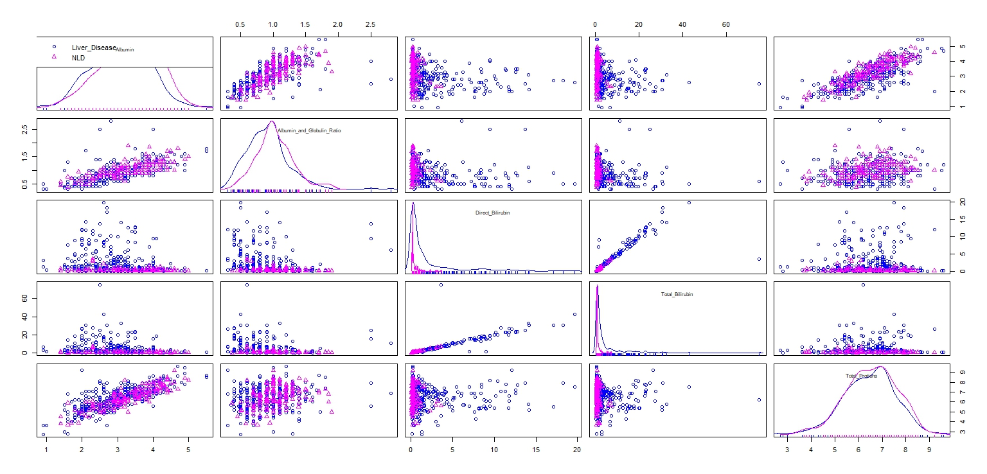
The scatterplot matrix depicts the overall view of relationship between all the continuous variables and the dependent variable(Disease).

Slide 5
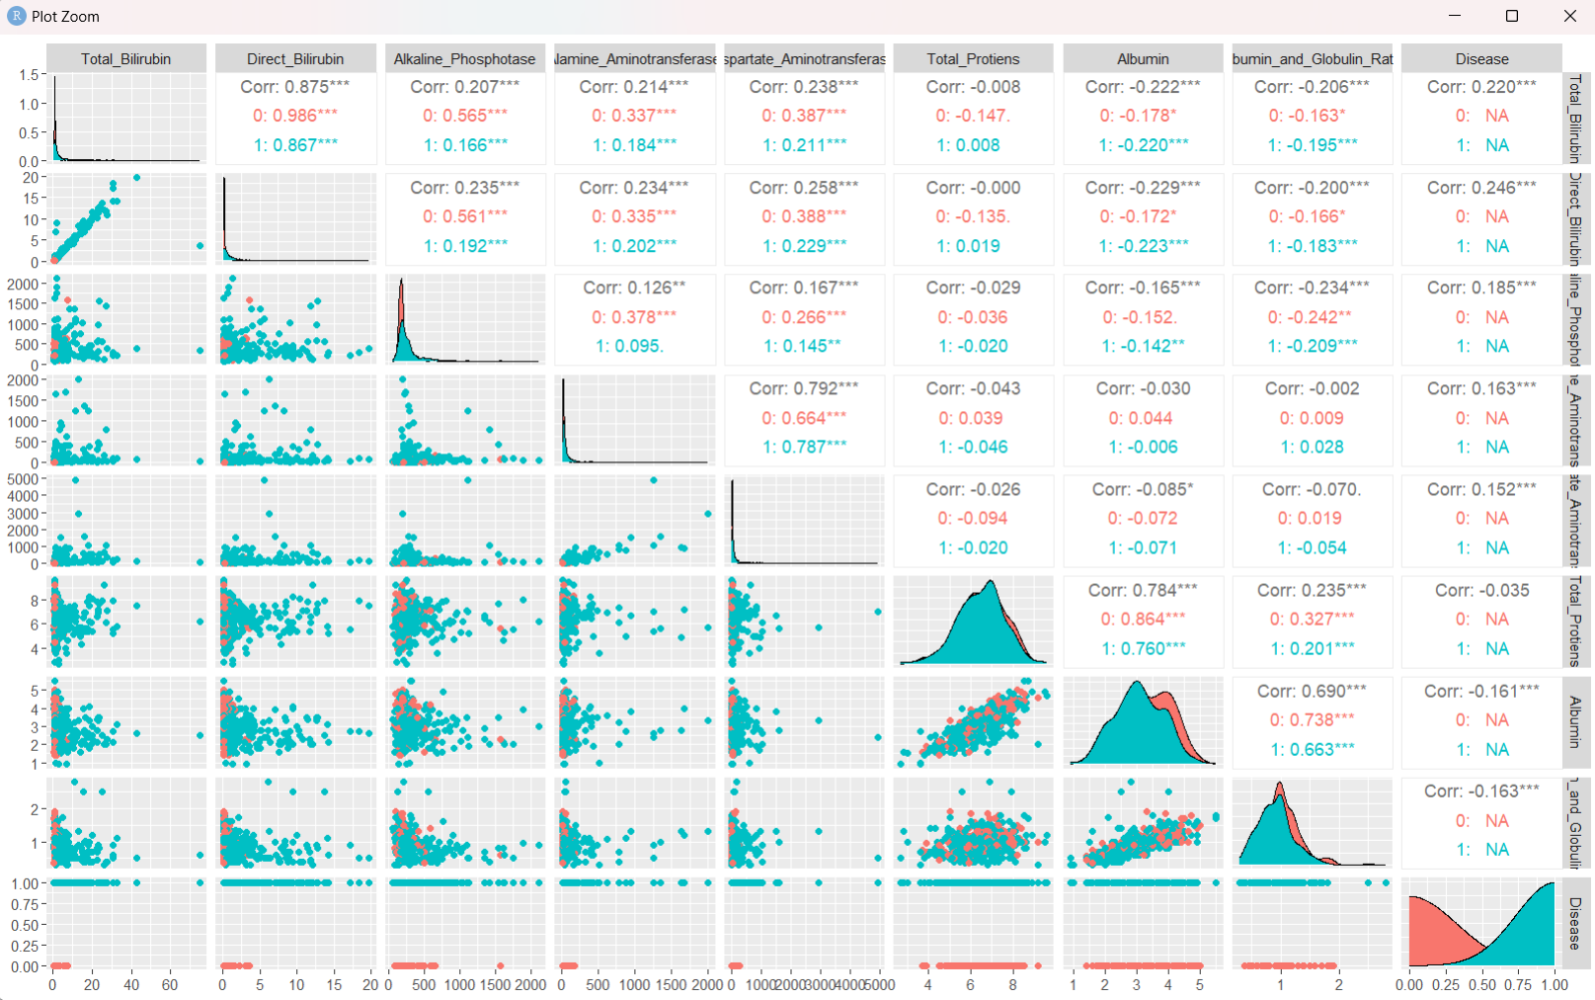

Slide 6
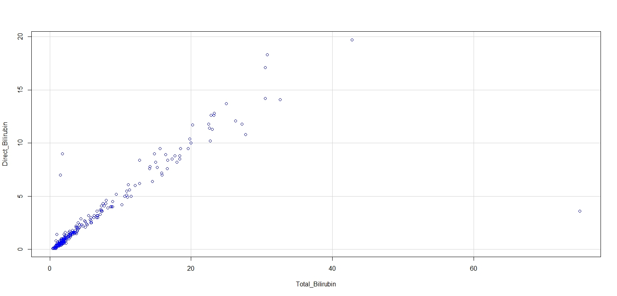
This is a scatter plot graphing the relationship between two variables: Total Bilirubin on the x-axis and Direct Bilirubin on the y-axis.
The scatterplot shows a positive correlation between total bilirubin and direct bilirubin. This means that as the level of total bilirubin increases, the level of direct bilirubin also tends to increase..

Slide 7
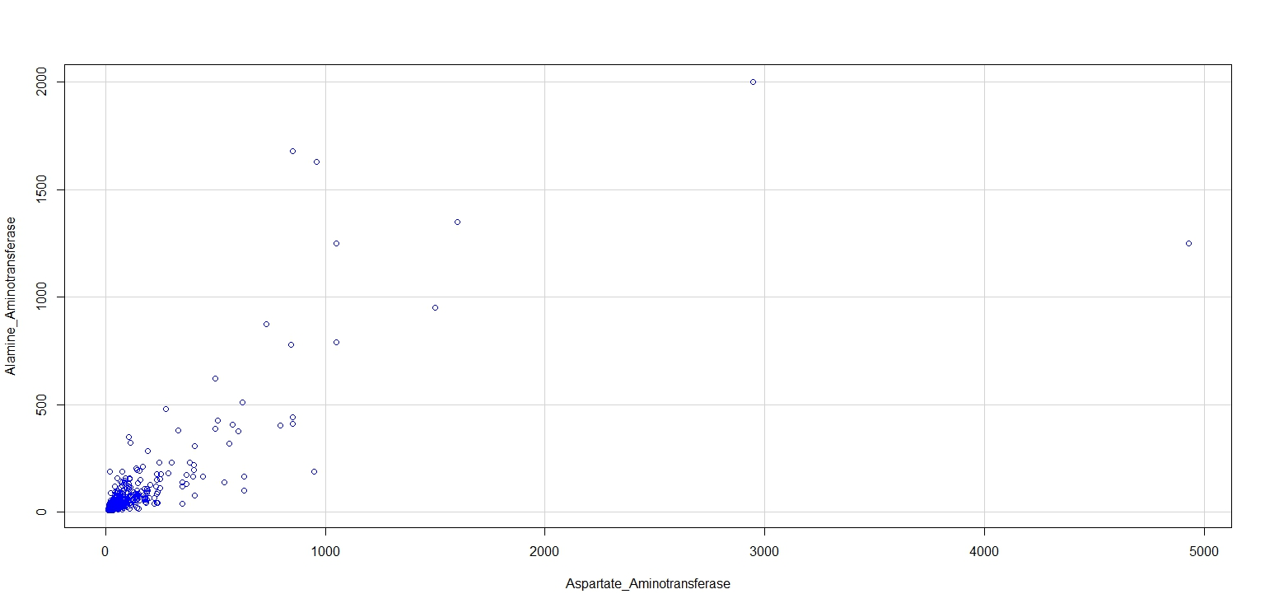
This graph is a scatter plot displaying the relationship between Aspartate' levels on the x-axis and ‘Alamine' levels on the y-axis.
The scatterplot shows a positive correlation between serum creatinine and serum sodium. This means that as serum creatinine levels increase, serum sodium levels tend to decrease.
There are also several data points that fall outside the main trend, which could be due to random chance or other factors that affect these levels.

Slide 8
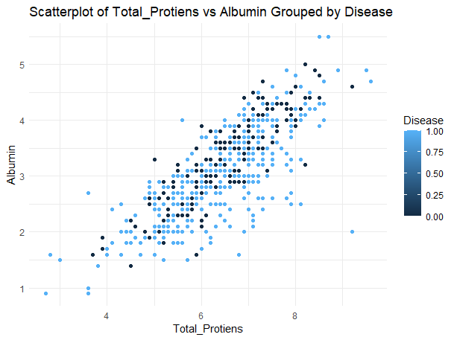
This graph is a scatter plot displaying the relationship between ‘Total Proteins’ on the x-axis and Albumin' on the y-axis.
There is a general trend of increasing Albumin with increasing Proteins.

Slide 9
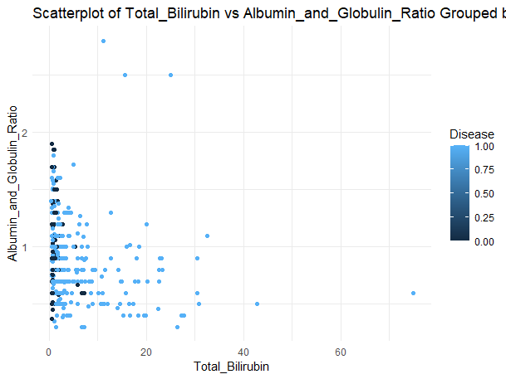
This graph is a scatter plot displaying the relationship between ‘Total Bilirubin’ on the x-axis and ‘Albumin_Globulin_ratio' on the y-axis.
There seems to be a weak negative correlation between Total Bilirubin and Albumin_Globulin_ratio.

Slide 10

correlation

Slide 11
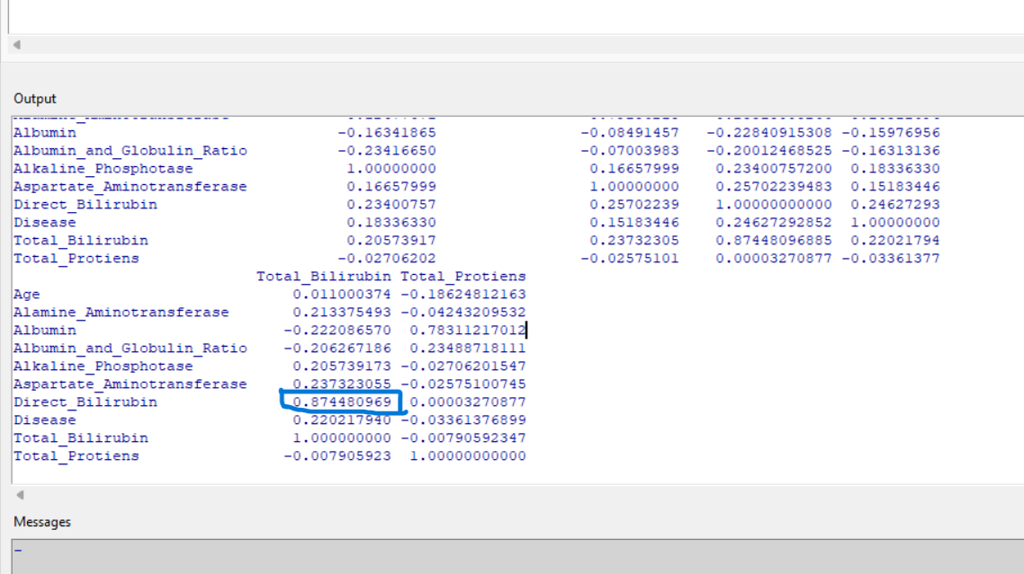
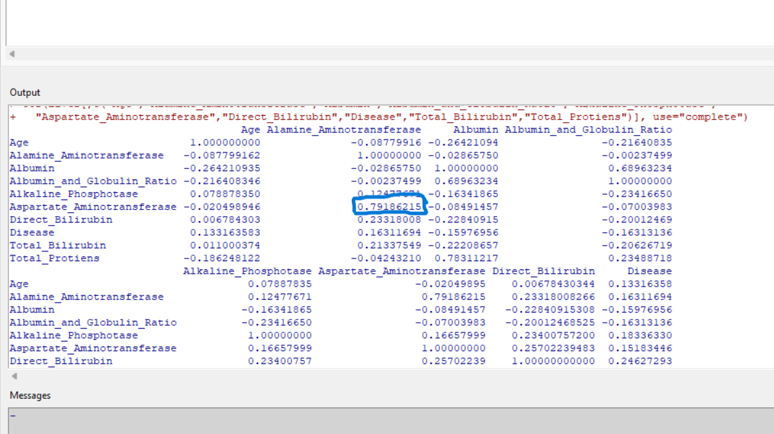
Going by the values the strong correlation exits between Total Bilirubin and Direct Bilirubin +ve value of 0.8744.
The second strongest correlation exits between Aspartate Aminotransferase and Alamine Aminotransferase with a value of 0.791.
Direct Bilirubin has the strongest correlation with Disease with a value of 0.246.

Slide 12

Logit

Slide 13
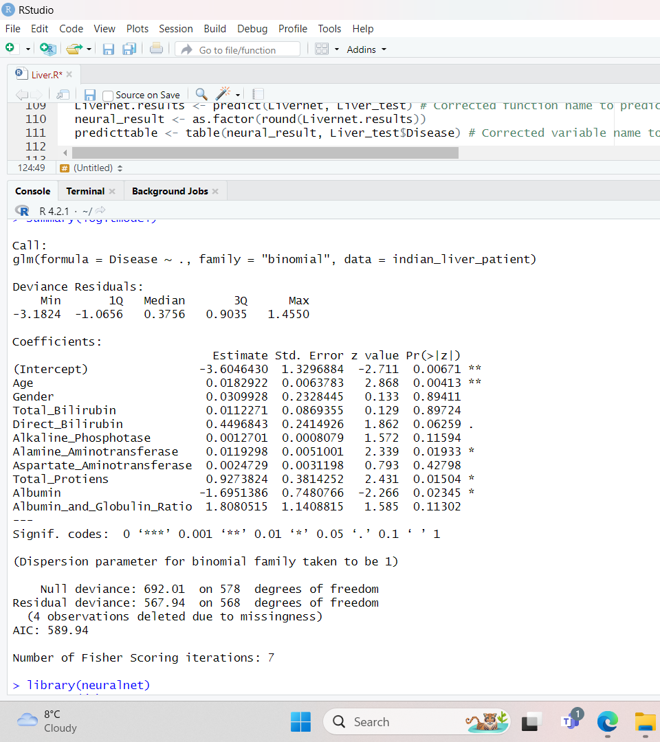
Out of all Explanatory Variables only Age, Alamine, Total Proteins and Albumin_Globulin_ratio are significant.

Slide 14
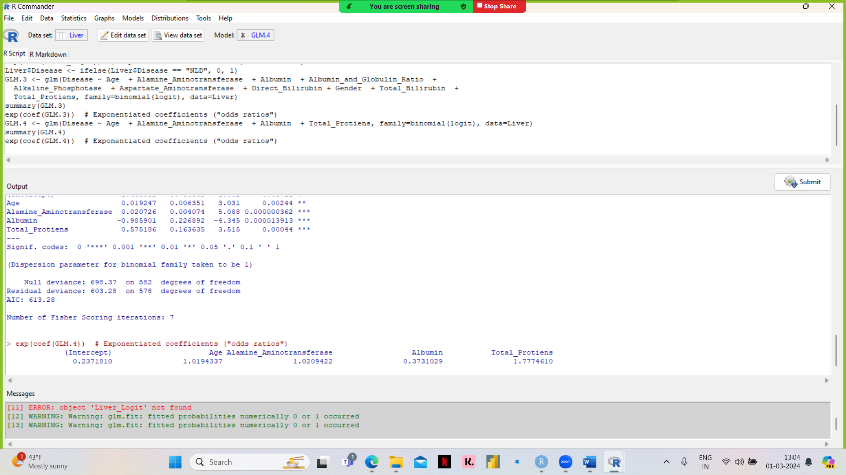
The coefficient for Age is 0.0192. This means that for each one-unit increase in Age, the log-odds of having the disease increase by 0.0192. Older individuals are more likely to have the disease compared to younger individuals.
The coefficient for Albumin is -0.9859. This means that for each one-unit increase in Albumin, the log-odds of having the disease decrease by 0.9859.
The coefficient for Alamine_Aminotransferase is 0.0207. This means that for each one-unit increase in Alamine_Aminotransferase, the log-odds of having the disease increase by 0.0207.
The coefficient for Total_Protiens is 0.5752. This means that for each one-unit increase in Total_Protiens, the log-odds of having the disease increase by 0.5752.

Slide 15
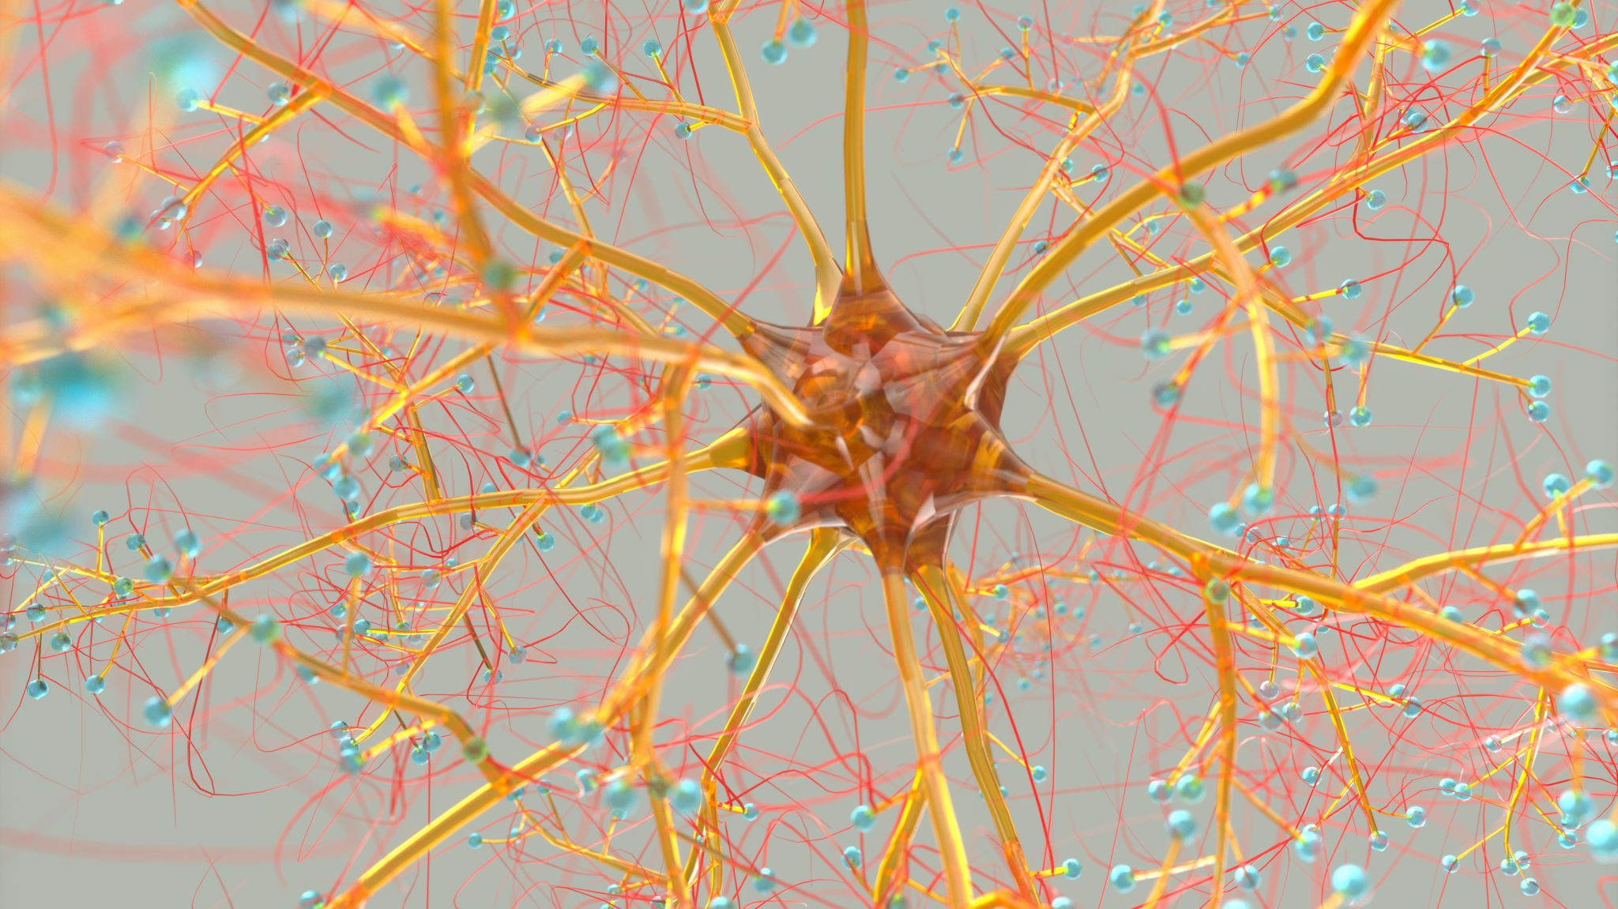
Neural networks

Slide 16
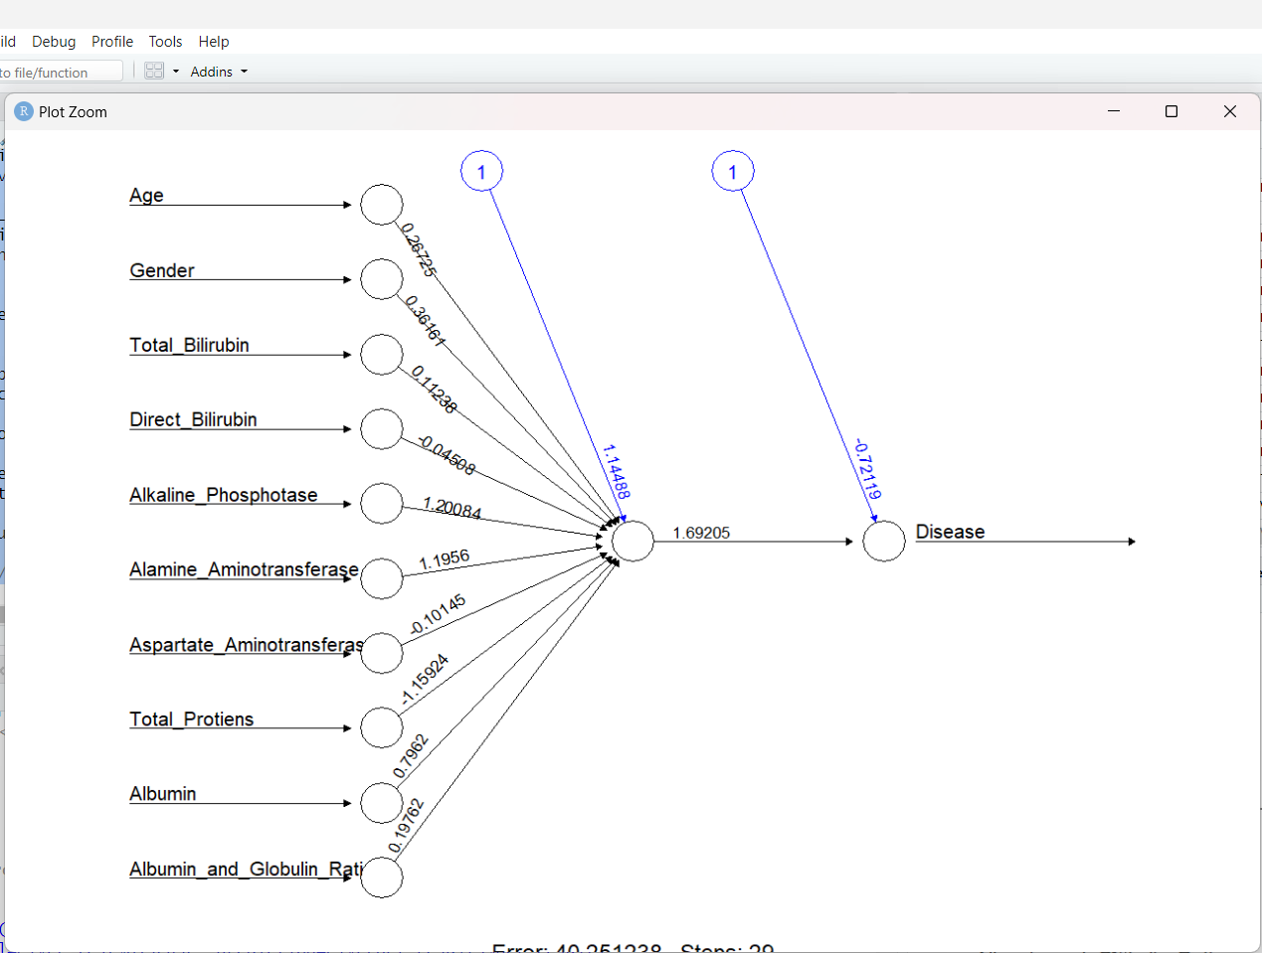
Neural network with All explanatory variables
We divided our dataset into a training set (70%) and a test set (30%) to train and evaluate a Neural Network model.
Subsequently, we use the test set to assess the accuracy of the Neural Networks. This process helps us understand how well the Neural Network performs in predicting Patients with Liver Disease based on the features in the dataset.
Hidden Layer: 1
Accuracy : 30.85%

Slide 17
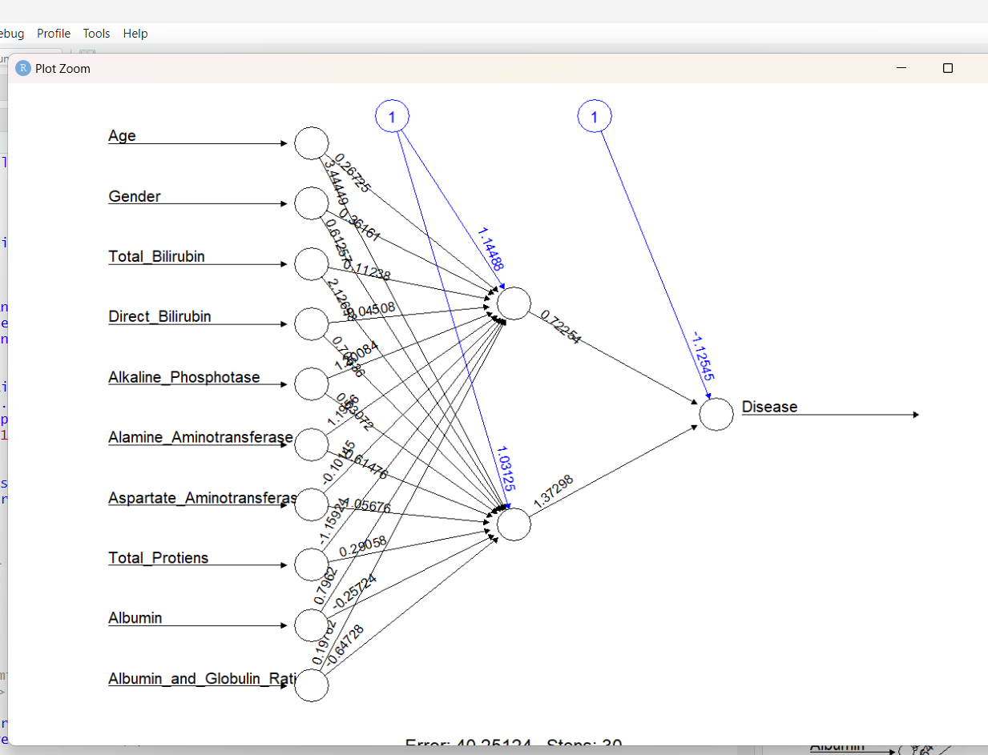
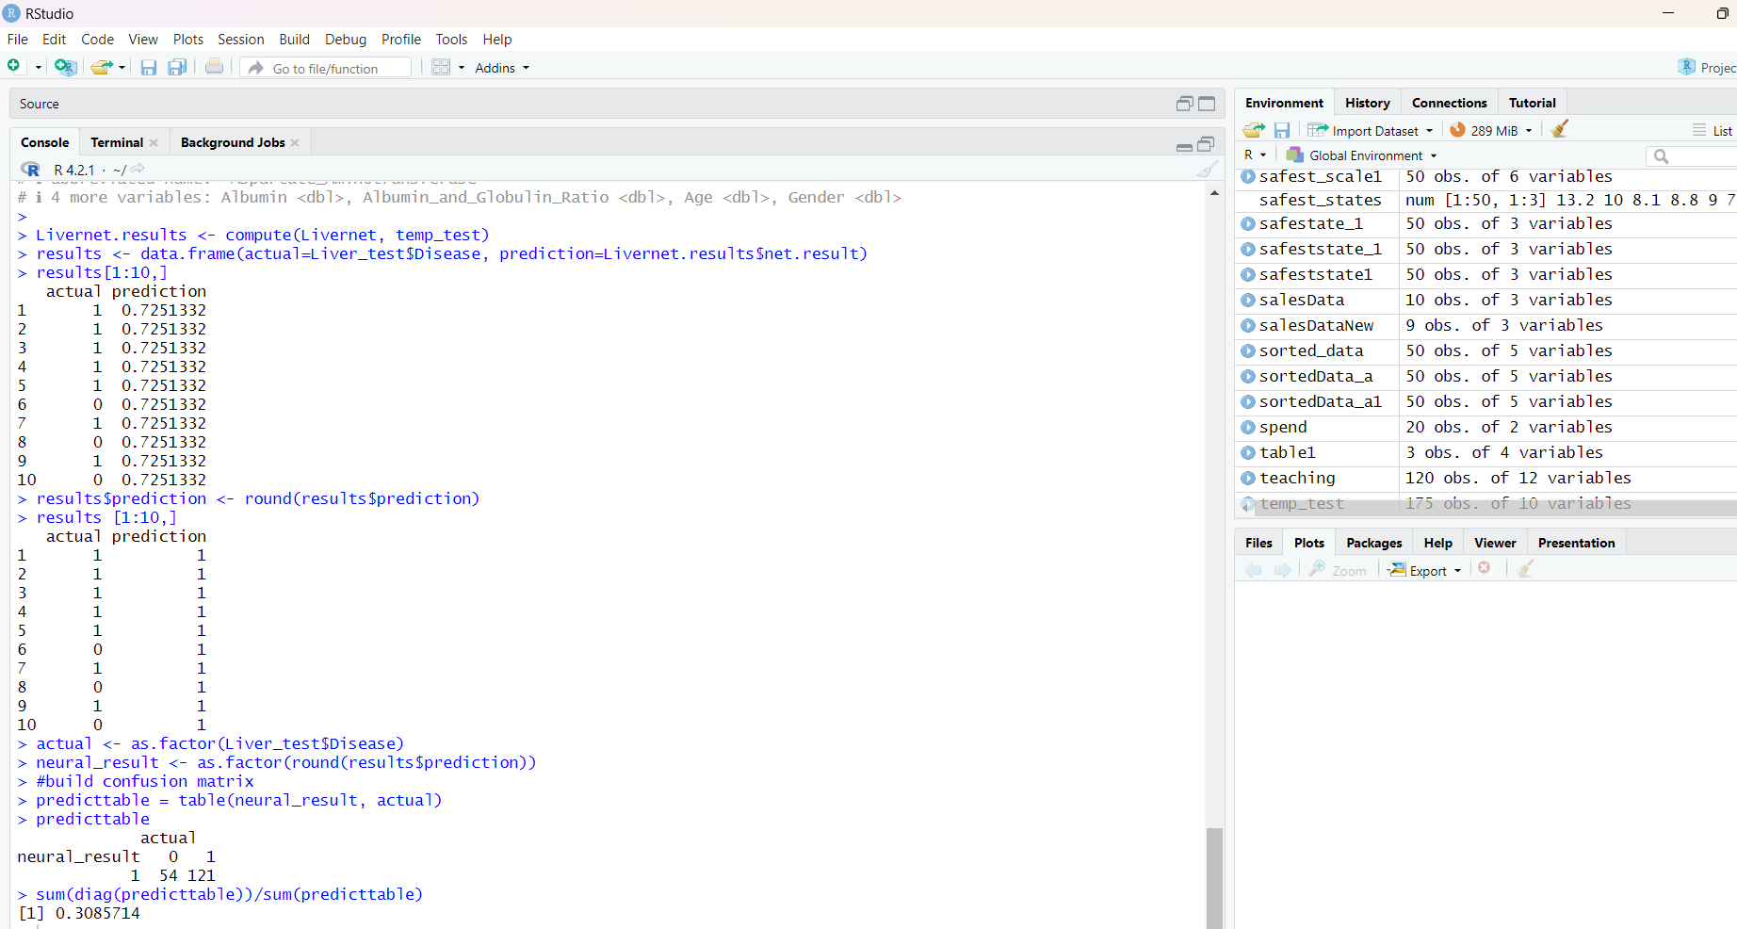
Hidden Layer:2 Accuracy: 30.85%

Slide 18
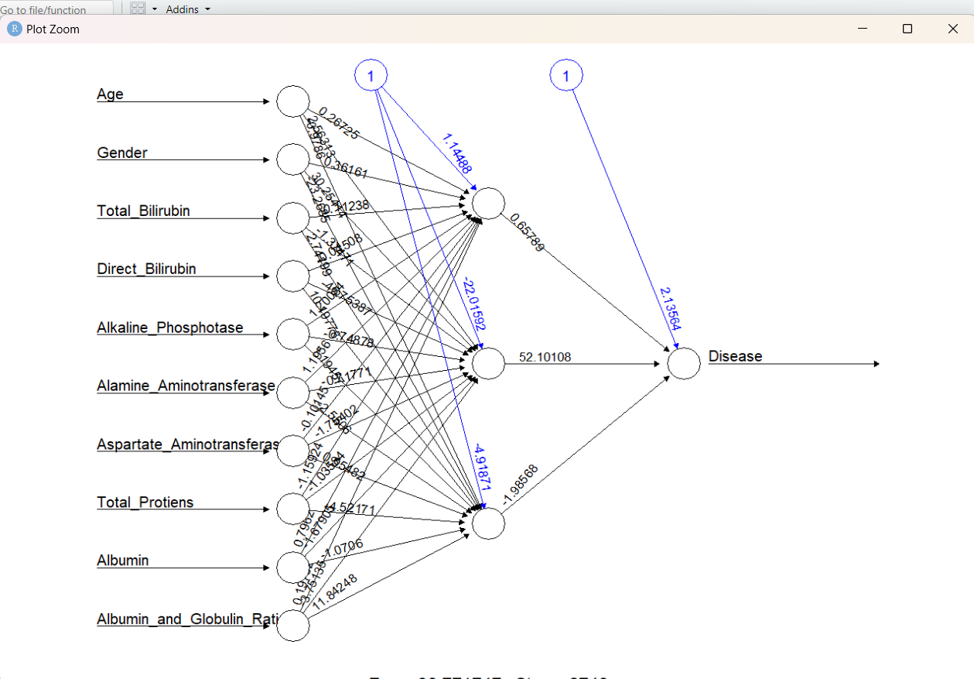
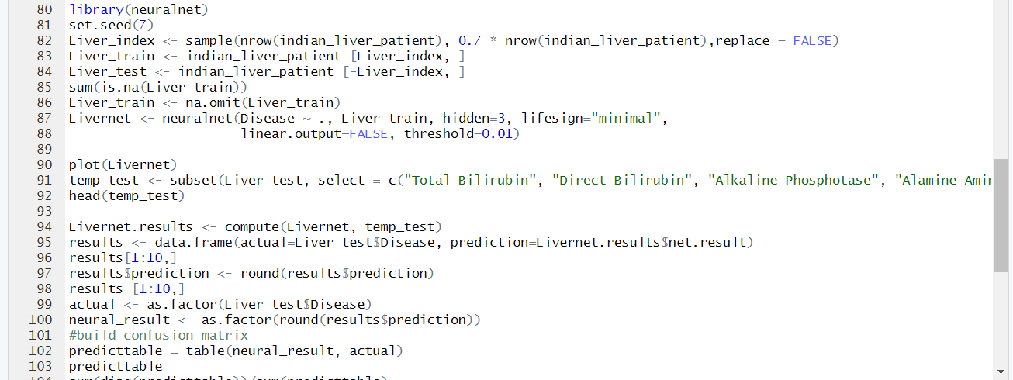
Hidden Layer: 3 Accuracy :30.85%

Slide 19
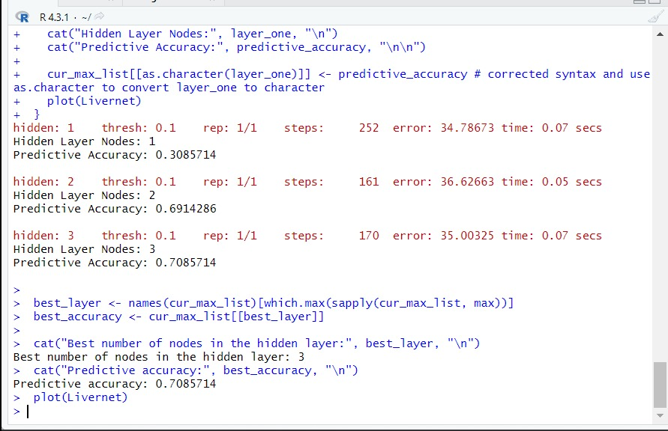
Neural network with significant explanatory variables
Disease ~ Age + Alamine_Aminotransferase +
Albumin + Total_Protiens

Slide 20
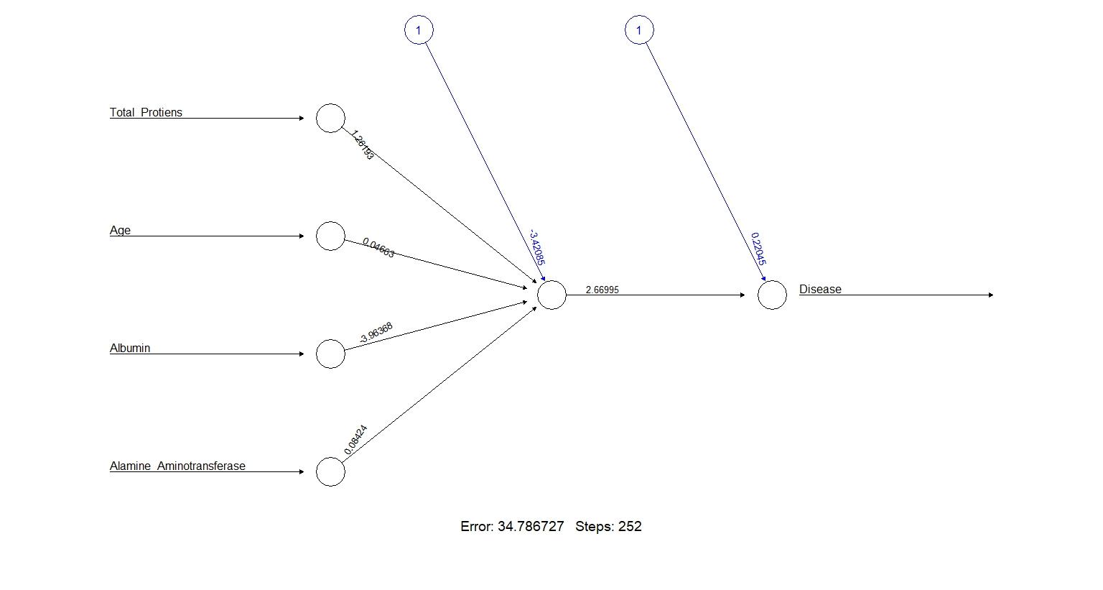
Neural network with 1 hidden layer
Hidden Layer:1
Accuracy : 0.308

Slide 21
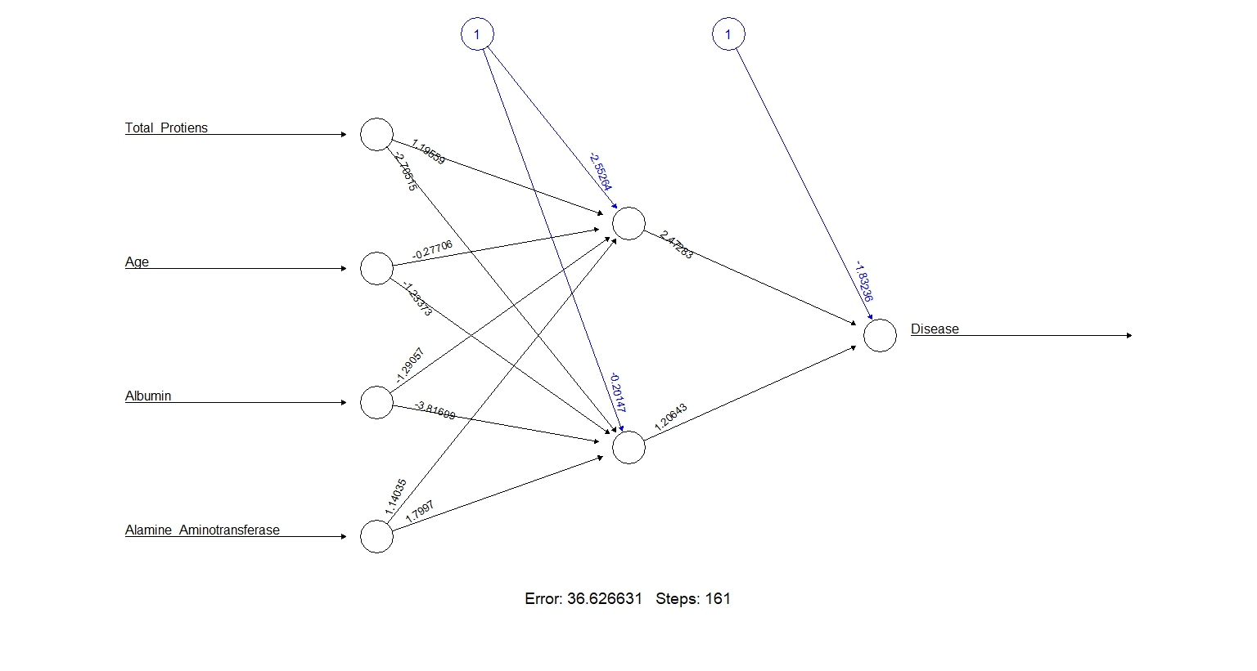
Neural network with 2 hidden layers
Hidden Layer:1
Accuracy : 0.691

Slide 22
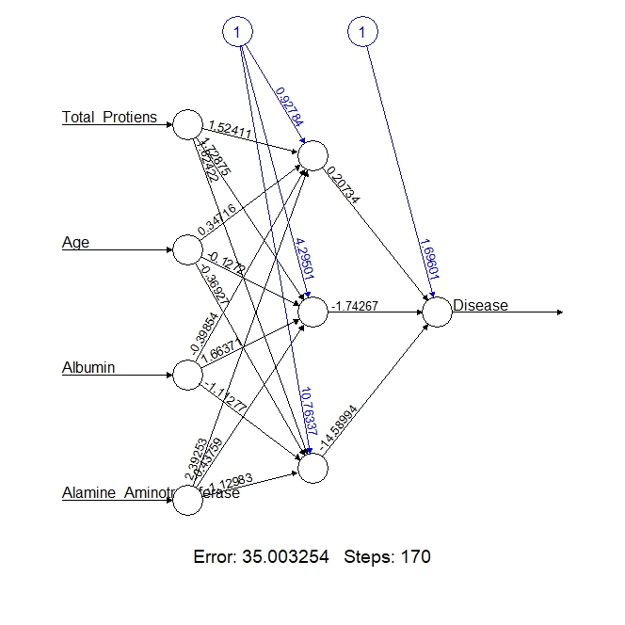
Neural network with 3 hidden layers
Hidden Layer:1
Accuracy : 0.708

Slide 23

Summary of neural networks
Neural Network using all Variables:
The accuracy of Neural Network model with all 3 hidden nodes is same with an accuracy of 30.85%.
Neural Network using Significant Variables:
The accuracy of NN using 1 hidden node is 30.85%.
The accuracy of NN using 2 hidden nodes is 69.1%.
The accuracy of NN using 3 hidden nodes is 70.8%.

Slide 24

Lessons learned

Slide 25
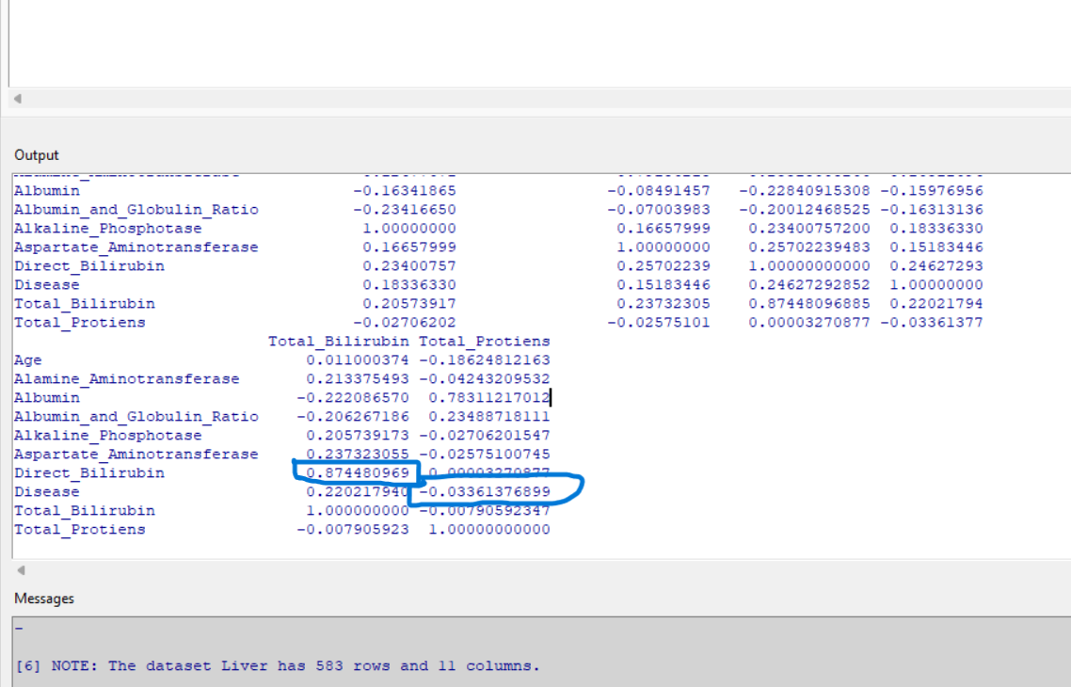
Correlation analysis provided insights into the linear relationships between variables, Specifically, it helped identify which variables had stronger correlations with the disease outcome.
Logistic regression (logit) considers these relationships in the context of predicting the binary outcome (disease status) and can account for non-linear associations and interactions between variables which may not necessarily align with correlation strengths.
For Example, The coefficient for Total_Protiens is 0.5752. This means that for each one-unit increase in Total_Protiens, the log-odds of having the disease increase by 0.5752 which is given by Logit, whereas correlation between Proteins and Disease is -0.033.
In summary, while correlation analysis provides valuable insights into the relationships between variables, logistic regression (or logit models) offers a more comprehensive approach to modeling binary outcomes, taking into account non-linear relationships, multicollinearity, and variable selection. Both approaches complement each other and contribute to a better understanding of the data and the predictive modeling process.

Slide 26

What did we learn after analysis?
We can observe the predictive accuracies of the neural networks for each configuration:
1. Neural networks with all explanatory variables:
- Hidden Layer Nodes: 1 - Predictive Accuracy: 0.385
- Hidden Layer Nodes: 2 - Predictive Accuracy: 0.385
- Hidden Layer Nodes: 3 - Predictive Accuracy: 0.385
2. Neural networks with only significant explanatory variables:
- Hidden Layer Nodes: 1 - Predictive Accuracy: 0.385
- Hidden Layer Nodes: 2 - Predictive Accuracy: 0.691
- Hidden Layer Nodes: 3 - Predictive Accuracy: 0.708
The model's performance did not improve with additional hidden layer nodes for the neural networks with all explanatory variables across different numbers of hidden layer nodes (1, 2, and 3).
Predictive accuracies for the neural networks trained on significant variables are higher than those trained on all explanatory variables, particularly for hidden layer nodes 2 and 3.
we can conclude that the logistic regression model using only significant variables helped in identifying a better neural network configuration, as evidenced by the higher predictive accuracies compared to using all explanatory variables. Specifically, the neural network with 3 hidden layer nodes achieved the highest predictive accuracy when trained on significant variables.

Slide 27

thank you

